Slide 1

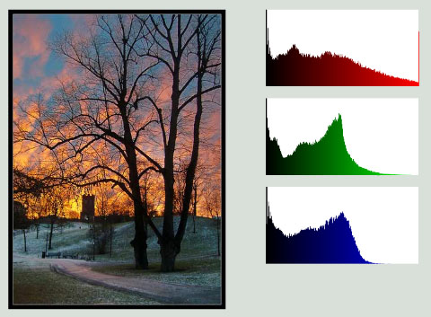

Slide 2
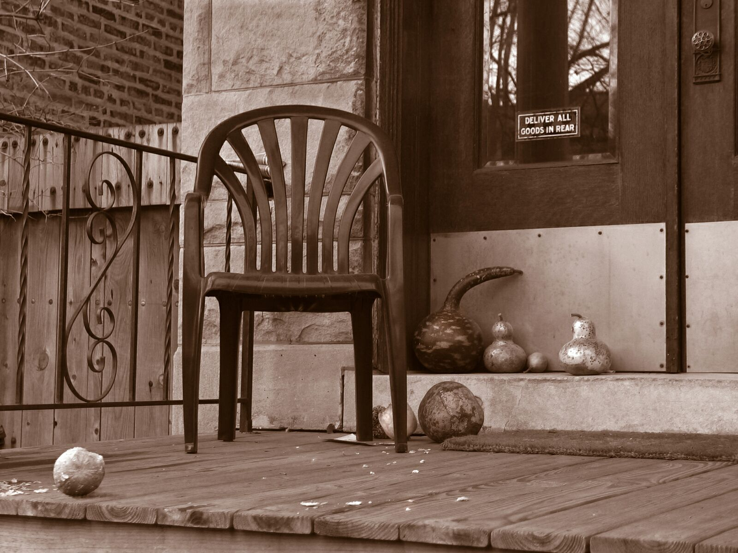
Image Characteristics

Slide 3
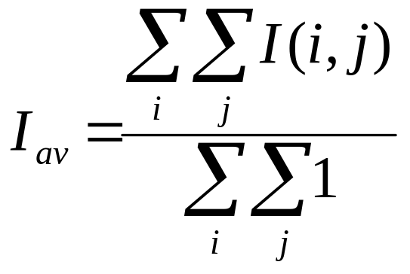
Image Mean
I
x
I
I_{NEW}(x,y)=I(x,y)-b
x

Slide 4
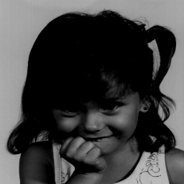
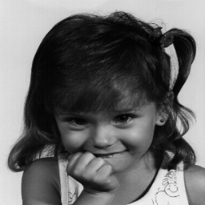
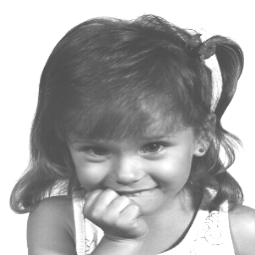
Changing the image mean

Slide 5
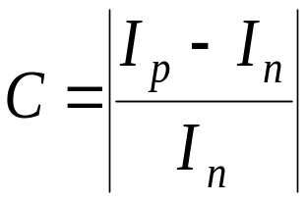


Image Contrast
The local contrast at an image point denotes the (relative) difference between the intensity of the point and the intensity of its neighborhood:
0.7
0.5
0.3
0.1

Slide 6
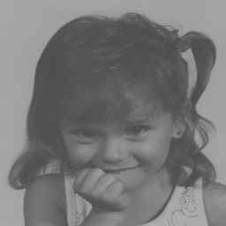
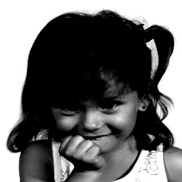
The contrast definition of the entire image is ambiguous
In general it is said that the image contrast is high if the image gray-levels fill the entire range
Low contrast
High contrast

Slide 7
I
I
x
x
I_{NEW}(x,y)=α·I(x,y)+β
How can we maximize the image contrast using the above operation?
Problems:
  Global (non-adaptive) operation.
  Outlier sensitive.

Slide 8
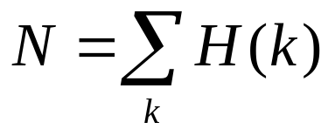
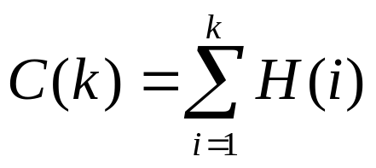
The Image Histogram
Occurrence
(# of pixels)
Gray Level
H(k) specifies the # of pixels with gray-value k
Let N be the number of pixels:
P(k) = H(k)/N defines the normalized histogram
defines the accumulated histogram

Slide 9
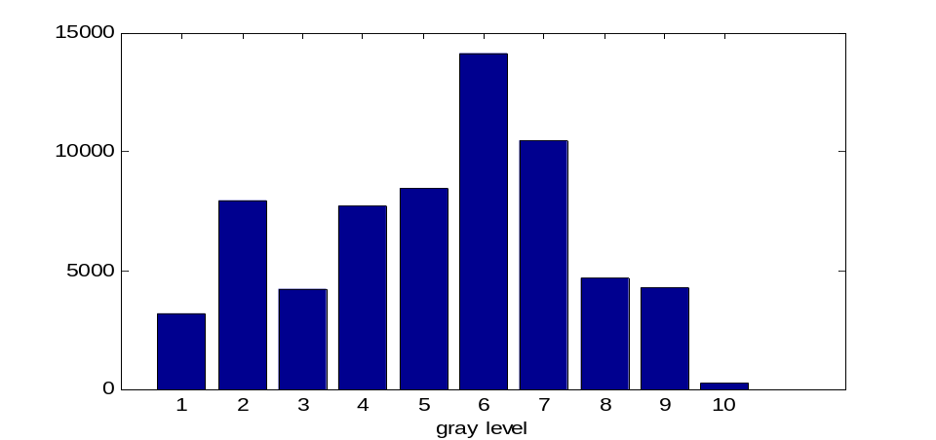
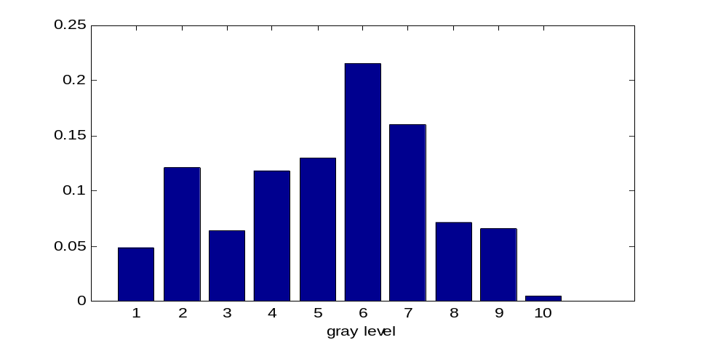
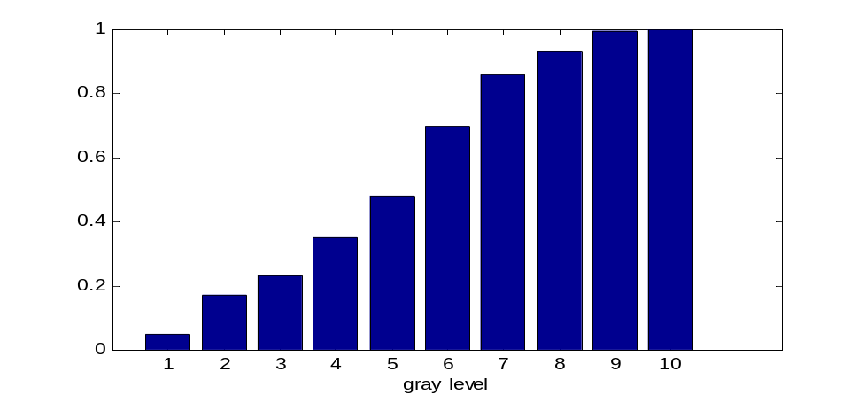
Histogram
Normalized Histogram
Accumulated Histogram

Slide 10
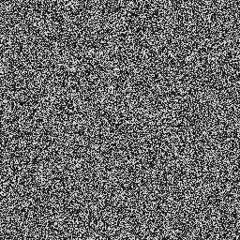
Examples
P(I)
P(I)
1
1
0.5
I
I
H(I)
H(I)
0.1
0.1
I
I
Pixel permutation of
the left image
The image histogram does not fully represent the image

Slide 11

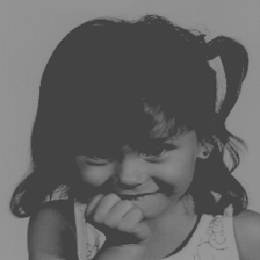
P(I)
Original image
0.1
I
P(I)
Decreasing contrast
0.1
I
P(I)
Increasing average
0.1
I

Slide 12
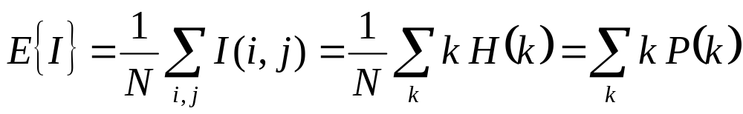
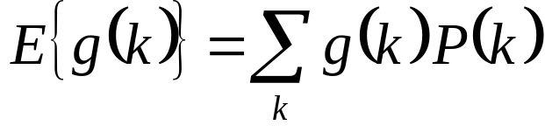
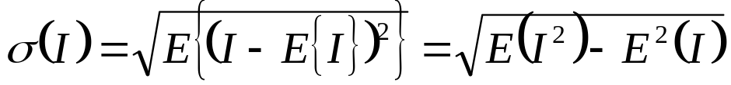
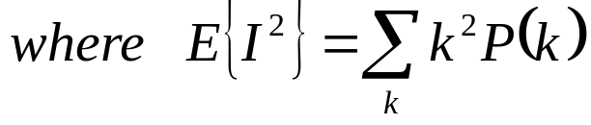
Image Statistics
The image mean:
Generally:
The image s.t.d. :
0.25
0.2
0.15
0.1
0.05
0
1
2
3
4
5
6
7
8
9
10
gray level

Slide 13
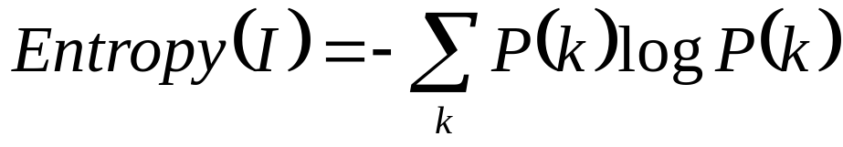
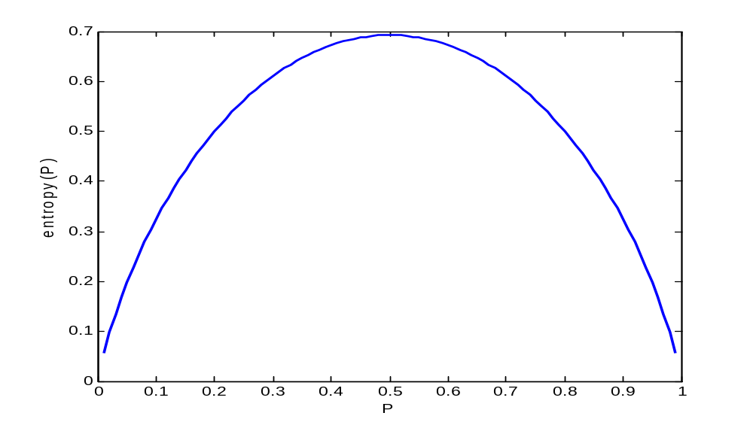
Image Entropy
The image entropy specifies the uncertainty in the image values.
Measures the averaged amount of information required to encode the image values.
Entropy of a 2 values variable

Slide 14
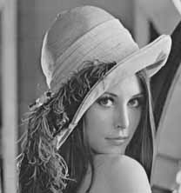
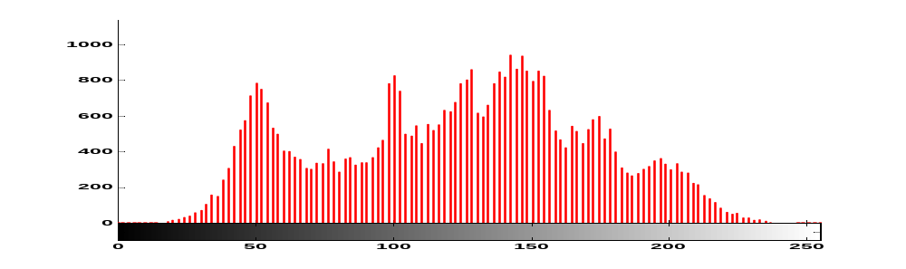

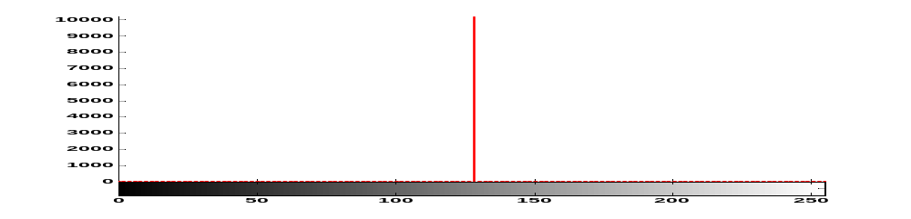
An infrequent event provides more information than a frequent event
Entropy is a measure of histogram dispersion
entropy=7.4635
entropy=0

Slide 15
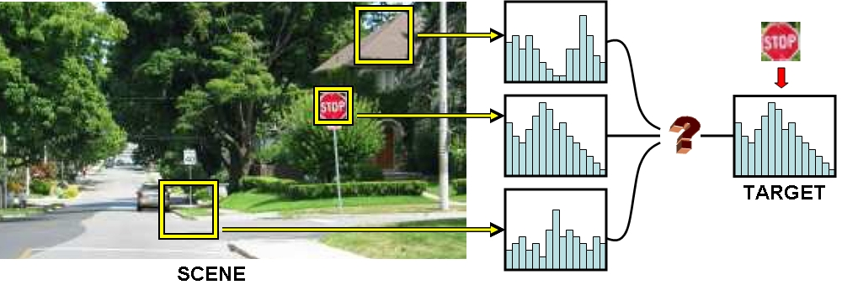
Adaptive Histogram
In many cases histograms are needed for local areas in an image
Examples:
  Pattern detection
  adaptive enhancement
  adaptive thresholding
  tracking

Slide 16
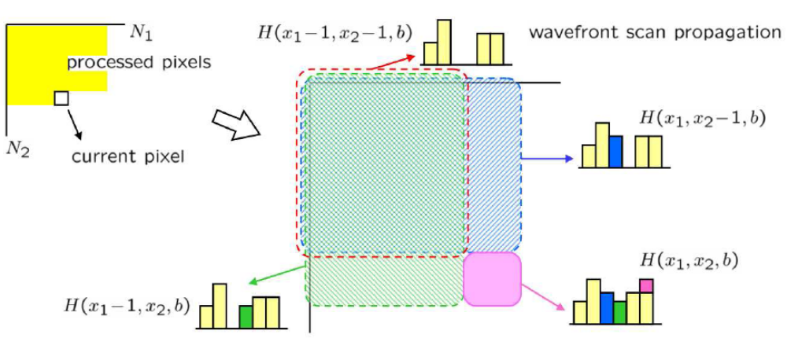
Implementation: Integral Histogram
H(x-1,y-1)
H(x,y-1)
H(x,y)
H(x-1,y)
porkili 05
Integral histogram: H(x,y) represent the histogram of a window whose right-bottom corner is (x,y)
Construct by can order:
H(x,y)= H(x,y-1)+H(x-1,y) – H(x-1,y-1)

Slide 17
Using integral histogram we can calculate local histograms of any window H(x₁:x₂,y₁:y₂)
x
y
(x₂,y₁)
(x₁,y₁)
(x₁,y₂)
(x₂,y₂)
H(x₁:x₂,y₁:y₂) =H(x₂,y₂)+ H(x₁,y₁)-H(x₁,y₂)-H(x₂,y₁)

Slide 18
Histogram Usage
Digitizing parameters
Measuring image properties:
  Average
  Variance
  Entropy
  Contrast
  Area (for a given gray-level range)
Threshold selection
Image distance
Image Enhancement
  Histogram equalization
  Histogram stretching
  Histogram matching

Slide 19

Example: Auto-Focus
In some optical equipment (e.g. slide projectors) inappropriate lens position creates a blurred (“out-of-focus”) image
We would like to automatically adjust the lens
How can we measure the amount of blurring?

Slide 20
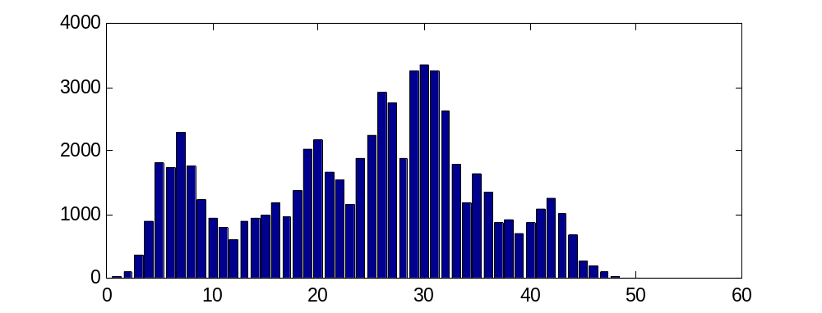
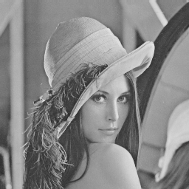
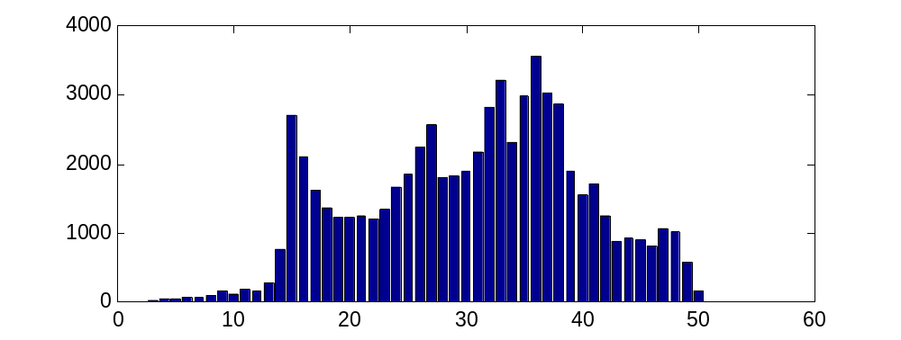

Image mean is not affected by blurring
Image s.t.d. (entropy) is decreased by blurring
Algorithm: Adjust lens according the changes in the histogram s.t.d.

Slide 21
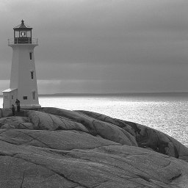
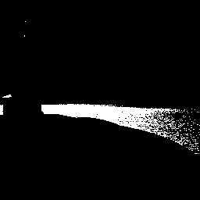
Thresholding
k_{new}
F(k)
255
k_{old}
255
Threshold value

Slide 22
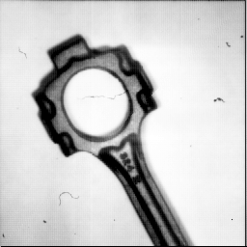
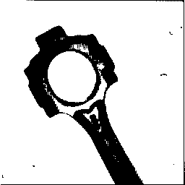
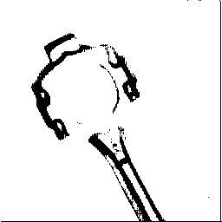
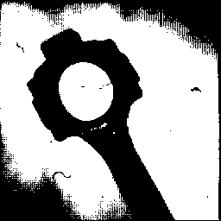
Threshold Selection
Original Image
Binary Image
Threshold too low
Threshold too high

Slide 23
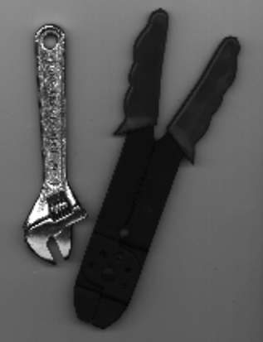
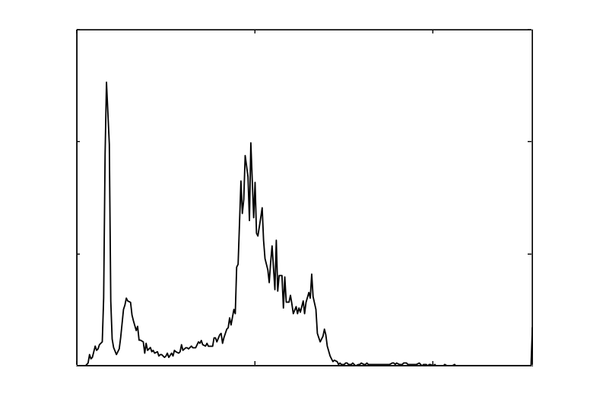
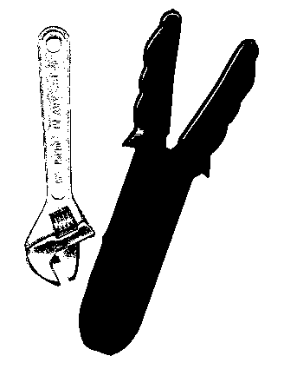
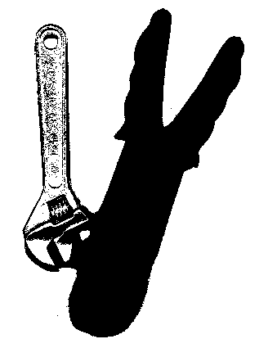
Segmentation using Thresholding
Original
Histogram
50
75
Threshold = 50
Threshold = 75

Slide 24
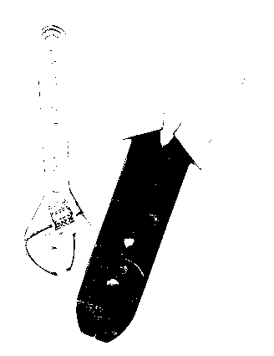
Segmentation using Thresholding
Original
Histogram
21
Threshold = 21

Slide 25
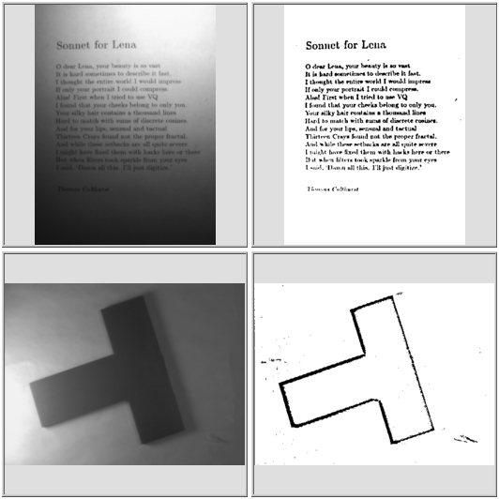
Adaptive Thresholding
Thresholding is space variant.
How can we choose the the local threshold values?

Slide 26
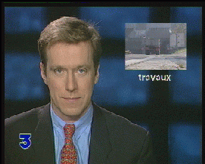
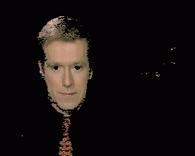
Color Segmentation
Segmentation is based on color values.
Apply clustering in color space (e.g. k-means).
Segment each pixel to its closest cluster.

Slide 27
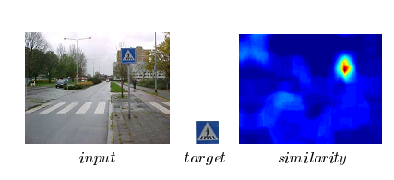
Histogram based image distance
Problem: Given two images A and B whose (normalized) histogram are P_{A} and P_{B} define the distance D(A,B) between the images.
Example Usage:
  Tracking
  Image retrieval
  Registration
  Detection
  Many more ...
Porkili 05

Slide 28
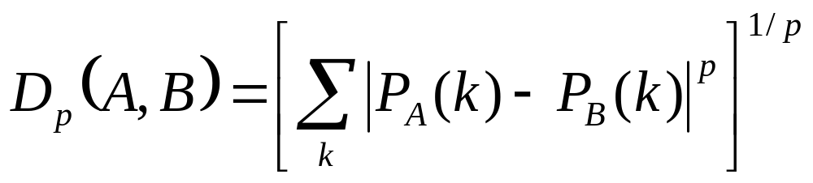
Option 1: Minkowski Distance
Problem: distance may not reflects the perceived dissimilarity:
<

Slide 29
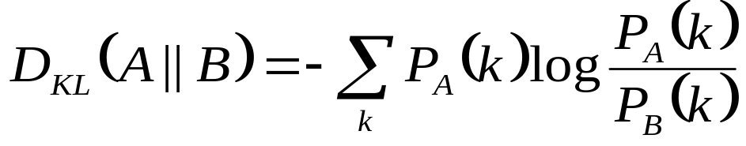
Option 2: Kullback-Leibler (KL) Distance
Measures the amount of added information needed to encode image A based on the histogram of image B.
Non-symmetric: D_{KL}(A,B)≠D_{KL}(B,A)
Suffers from the same drawback of the Minkowski distance.

Slide 30
Option 3: The Earth Mover Distance (EMD)
Suggested by Rubner & Tomasi 98
Defines as the minimum amount of “work” needed to transform histogram H_{A} towards H_{B}
The term d_{ij} defines the “ground distance” between gray-levels i and j.
The term F={f_{ij}} is an admissible flow from H_{A}(i) to H_{B}(j)
>

Slide 31


Option 3: The Earth Mover Distance (EMD)
≠
From: Pete Barnum

Slide 32


Option 3: The Earth Mover Distance (EMD)
≠
From: Pete Barnum

Slide 33
Option 3: The Earth Mover Distance (EMD)
=
From: Pete Barnum

Slide 34

Option 3: The Earth Mover Distance (EMD)
(amount moved)
=
From: Pete Barnum

Slide 35
Option 3: The Earth Mover Distance (EMD)
work=(amount moved) * (distance moved)
=
From: Pete Barnum

Slide 36
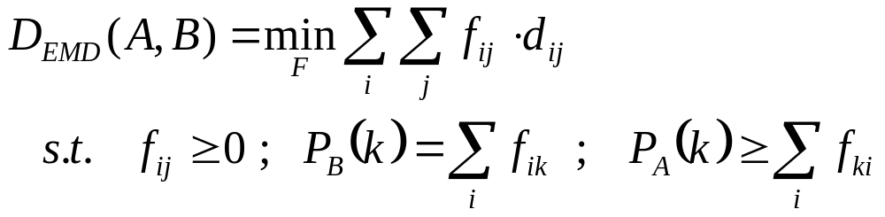
Option 3: The Earth Mover Distance (EMD)
Constraints:
  Move earth only from A to B
  After move P_{A} will be equal to P_{B}
  Cannot send more “earth” than there is
Can be solved using Linear Programming
Can be applied in high dim. histograms (color).

Slide 37
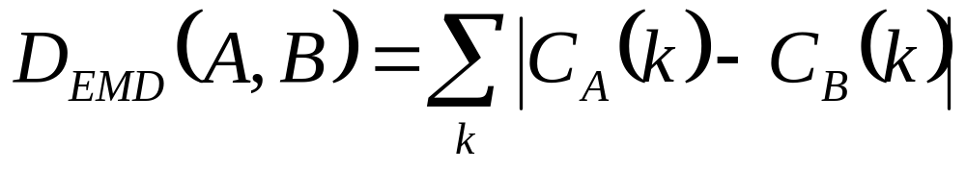
Special case: EMD in 1D
Define C_{A} and C_{B} as the accumulated histograms of image A and B respectively:
P_{A}
C_{A}
P_{B}
C_{B}
C_{A}-C_{B}

Slide 38
T H E E N D

